Slide 1

Qfold: rna Secondary Structure prediction
Amit Verma
Todd Eckdahl
Mark Lewis

Slide 2
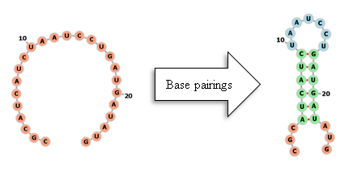
RNA Secondary Structure Prediction
Given a sequence S of nucleotides S = (x₁, x₂, x_{i}, …, x_{n}) where x_{i} ∈{A, C, G, U}
The primary structure
Given interaction weights between pairs (e.g. Turner’s weights)
Given rules for base pairing
What is the corresponding secondary structure?
Note that the problem is not deterministic

Slide 3
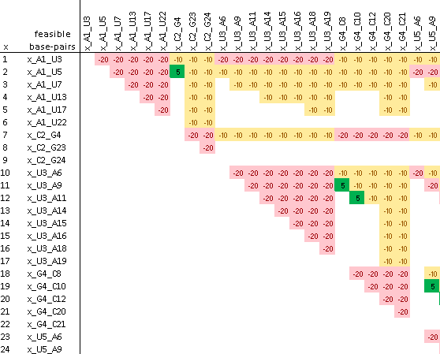
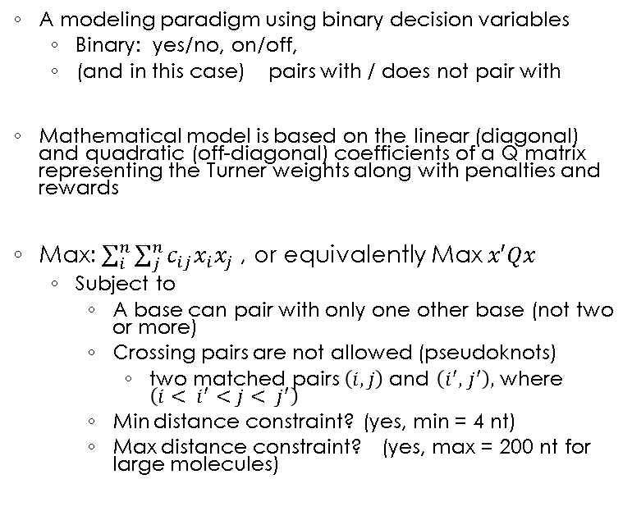
Quadratic Unconstrained Binary Optimization (QUBO)
A modeling paradigm using binary decision variables
Binary: yes/no, on/off,
(and in this case) pairs with / does not pair with
Mathematical model is based on the linear (diagonal) and quadratic (off-diagonal) coefficients of a Q matrix representing the Turner weights along with penalties and rewards
Max: $\sum_{i}^{n}{\sum_{j}^{n}{{c_{ij}x}_{i}x_{j}}}$ , or equivalently Max $x′Qx$
Subject to
A base can pair with only one other base (not two or more)
Crossing pairs are not allowed (pseudoknots)
two matched pairs $\left(i, j\right)$ and $\left(i^{′}, { j}^{′}\right),$ where $\left(i< i^{′}<j< j^{′}\right)$
Min distance constraint? (yes, min = 4 nt)
Max distance constraint? (yes, max = 200 nt for large molecules)
Q =

Slide 4
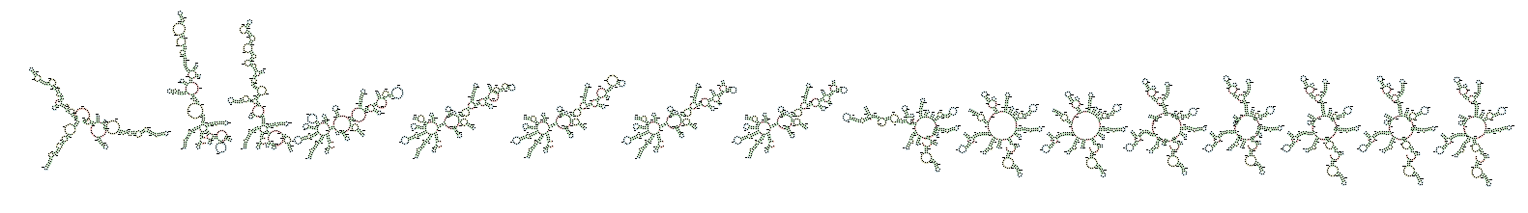
Qfold software
Input: RNA sequence
Outputs:
Progression of secondary structures from higher to lower free energy (MFE)
Dot-parenthesis structure
Matthew’s Correlation Coefficient and other similarity measures
Molecule ASE_00010 progression of sub-optimal secondary structures (left-to-right is high MFE to low) using ViennaRNA http://rna.tbi.univie.ac.at/forna/

Slide 5
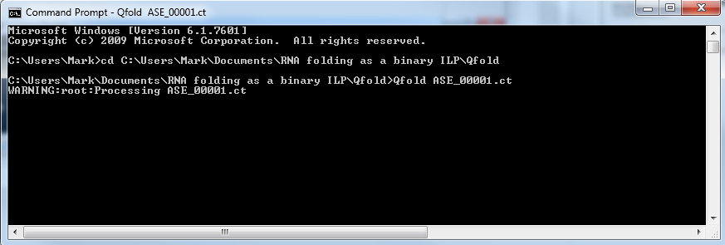
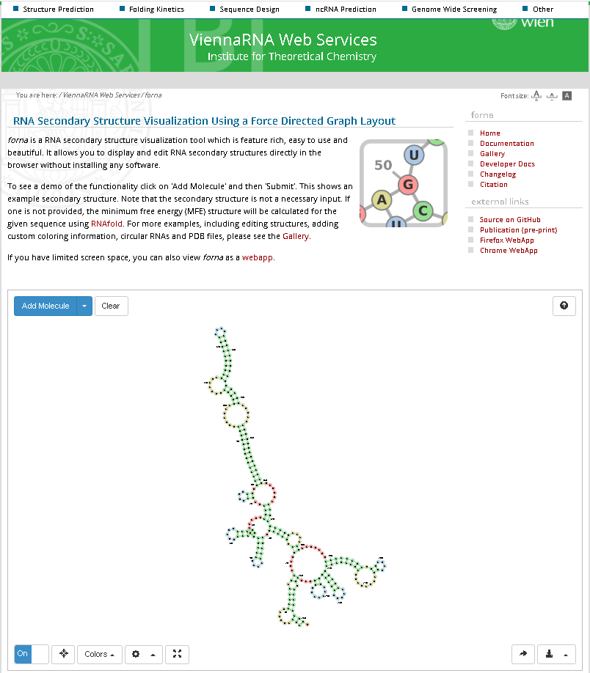
Qfold Directions (Windows OS)
Download files GitHub
Unzip to a folder you can find and copy the address of the folder (Ctrl-c)
Open a Command Prompt window and type “cd” then right-click and choose Paste to paste in the address of the folder
Pick the .ct file for an RNA sequence (recommended less than ~500 nt), e.g. ASE_00001.ct
Type “Qfold ASE_00001.ct”
and the program will begin running for one minute. Notice the output files generated.
Copy/paste the files with the dot-parenthesis notation into Add Moleucle window of ViennaRNA http://rna.tbi.univie.ac.at/forna/

